Slide 1

Slide 1
Java Data Base Connectivity
A Unit of iBirds Group
STAR INFOTECH COLLEGE
Affiliated to MDS University
INVESTOR OPPORTUNITY

Slide 2
Slide 3
What we will be learn today
JDBC Overview.
JDBC Driver and its types.
Steps for Connect to Database.
Used Package Overview.
Perform CRUD operation with Database.
Points to Remember.
Do some Hands-On Exercise.

Slide 3



Slide 3
Basic Application Framework
< >
Front End
UI (User Interface)
Back End ( Processing Data )
C, C++, PHP, C#, Java etc
Database ( Storing Data )
Access, Oracle, MySql etc.

Slide 4
Slide 3
JDBC Overview
JDBC allows a Java programmer to access any kind of database in a Java application.
JDBC allows the programmers to develop Java applications that can : -
Connect to a data source, such as a database.
Retrieve and process the results received from the database.
Send insert and update statements to the database.

Slide 5

Slide 3
JDBC Driver
A JDBC driver is a collection of Java classes that enables a programmer to connect a Java application to a certain database.
< >
Back End ( Processing Data )
C, C++, PHP, C#, Java etc
JDBC Driver
Database ( Storing Data )
Access, Oracle, MySql etc.

Slide 6
Slide 3
Types of JDBC Driver
There are four types of drivers to connect with different types of databases. These are :-
Native API Driver
(ODBC Bridge) ---> DSN ---> Access , SQL Server etc Database
Language Specific Driver
Visual Basic Application --> Visual Data Manager
Third Party Tool Driver
Partial Java dependent --> Partial Java (.zip)
Pure Java Driver (.jar)
Pure Java Specific
com.mysql.jdbc.jar (for mysql / mysqli)
oracle.jdbc.jar (for oracle)
sql.jdbc.jar (for sql server)
(We use Driver class for load that jar file.)

Slide 7
Slide 3
Steps to Connect Database
Import the package.
Load and Register the Driver.
Establish the Connection with Database.
Create the statement.
Execute the Query.
Process Result.
Close the connection.

Slide 8
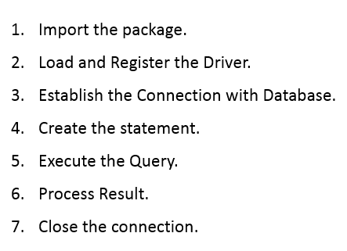
Slide 3
Package Overview
java.sql.*;
DriverManager (Class) :
registerDriver(DriverClassObject), getConnection(DatabasePath/connectionstring)
Connection (Interface) :
createStatement(), prepareStatement(), prepareCall()
Statement (Interface) :
Action Query (Insert/Update/Delete) --> executeUpdate()
Record Query (Select) ----> executeQuery()
PreparedStatement (Interface)
CallableStatement (Interface)
ResultSet (Interface):
getInt(FieldName/Position),
getString(FieldName/Position) etc.
ResultSetMetaData(Interface)
DatabaseMetaData(Interface)

Slide 9
Slide 3
Quick Database Overview
Database : It is a systematic collection of data.
Table : Tables are combination of Rows(records) and columns(fields).
Columns / Fields
roll_no | name | email | mobile_no
1 | Pradeep | pradeep@gmail.com | 123456789
Rows / Records
Students Table

Slide 10

Slide 3

Slide 11
Slide 3
Points to Remember
Setup Database first.
Compile By :
set classpath = <Jar File Path>.jar
javac FileName.java
Execute By :
set classpath = <Jar File Path>.jar ; <Current Folder Path> or .
java className

Slide 12
Slide 3
Do some hands-on exercise
Make a Database ‘office’ with table ‘employees’ with fields employee_id, name, gender, phone_no, address and do following operations :-
Insert 2 records in table.
Show Table Records.

Slide 13

Slide 3
ANY QUESTIONS ?

Slide 14

Slide 15
THANK YOU!
CONTACT US AT:
admin@ibirdscollege.com
8890488666, 7073125888, 6375154474
Group
#StaySafeAtHome #DoCode

